Slide 1
Climatlantic Energy & Climate Forum March 13th Dublin, Ireland Renewables & Energy Policy
13th March 2014
Angela.treanor@rpsgroup.com

Slide 2
European Energy Policy
Renewable Energy Directive 2009/28/EC
Ireland’s target of 16% by 2020
Ahead of our 2012 interim target
2012: RES 7.1% (19.6% RES-E, 3.8% RES-T and 5.2% RES-H)
Still unclear what fines/penalties will be imposed for non-compliance
Energy trading system logistics unclear also e.g. Market processes, target trading, Intergovernmental agreement for direct export to the UK unlikely to proceed

Slide 3
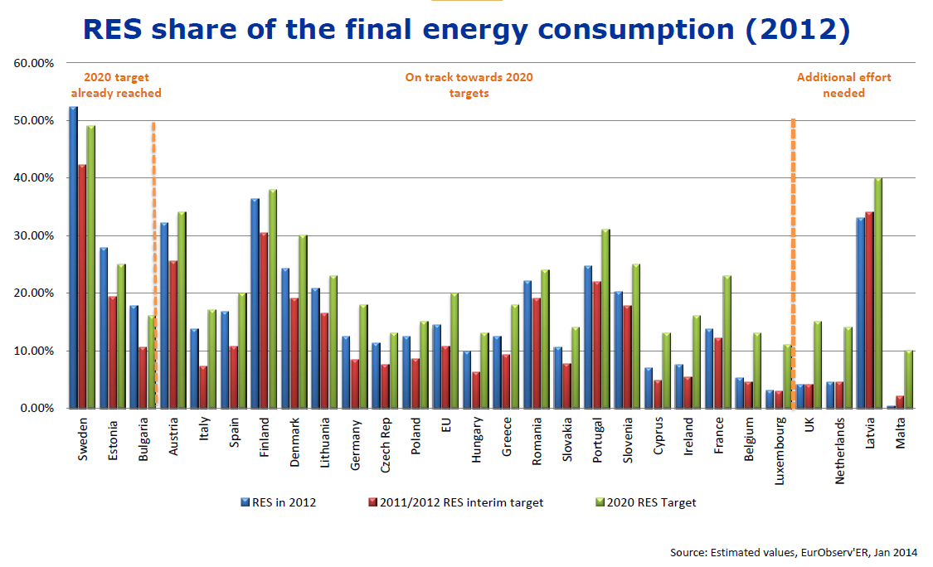
European Energy Policy

Slide 4
European Energy Policy
EU Climate 2030 Updates
Move to more climate focused policies
Specific carbon reduction targets – 40%
Specific RES targets – 27%
Requirement to develop National Energy Plans – increased focus on market integration and consultation with neighbours
Energy Efficiency target not yet set (potentially mid 2014)

Slide 5
Irish Energy Policy 2014 Updates
Green Paper on Energy Policy Framework
Due for publication end 2014
6 Priorities (identified at RE Summit)
Empowering Energy Citizens/Consumers
Stability of Markets and the Regulatory Framework
Planning and Implementing Essential Energy Infrastructure
Ensuring a Balanced Energy Mix
Putting Energy Systems on a Sustainable Basis
Driving Economic Opportunity
Wind Energy Guidelines Revision
Due 2014
Focus on Noise and Shadow Flicker

Slide 6
Irish Energy Policy 2014 Updates
Bioenergy Strategy (due 2014)
Lead with demand and support market for biomass with enabling measures for supply chains
Recommendations thus far (as per RE Summit)
Establishment of Cross Departmental Advisory Group
Continued implementation of existing bioenergy policies
Additional targeted policy intervention to incentivise heat users to adopt renewable energy
Strategy will lead to new market outlets being created for biomass
Complementary set of “supply side” policies that will facilitate Irish biomass producers to meet that demand
Strategy will act as an economic stimulus

Slide 7
Bioenergy – Where we are now
Bioenergy contributed 3 percentage points (of 7.1% in 2012)
Expected to deliver about 50% of RES in 2020
Current support in place
REFIT 2 & 3
Biofuel Obligation Scheme
Part L Building Regulations
Acknowledged that additional policies required to meet 2020 targets
Renewable Heat Incentive one such industry proposal (Coillte RHI Review)

